Slide 1
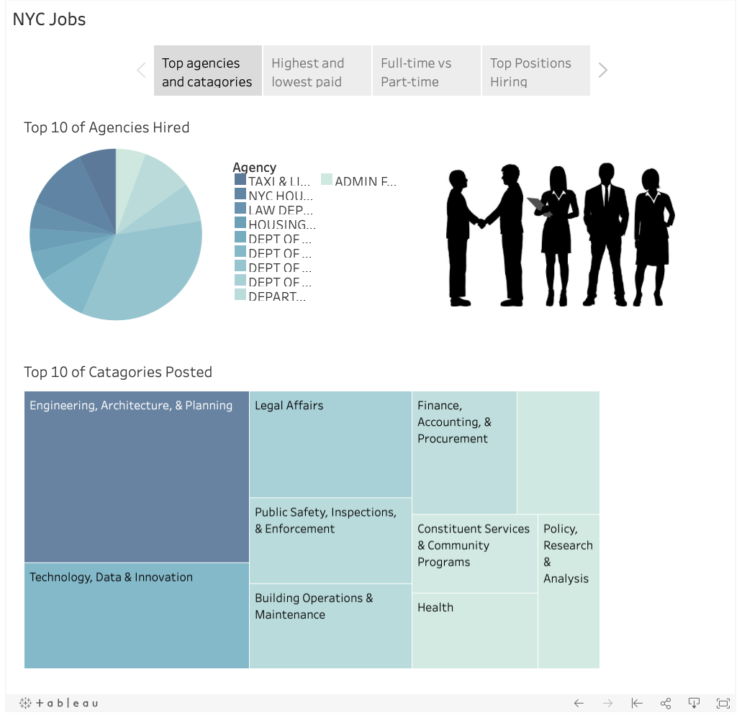
Nyc jobs
Top agencies and categories are linked to show the relationship between the two.

Slide 2
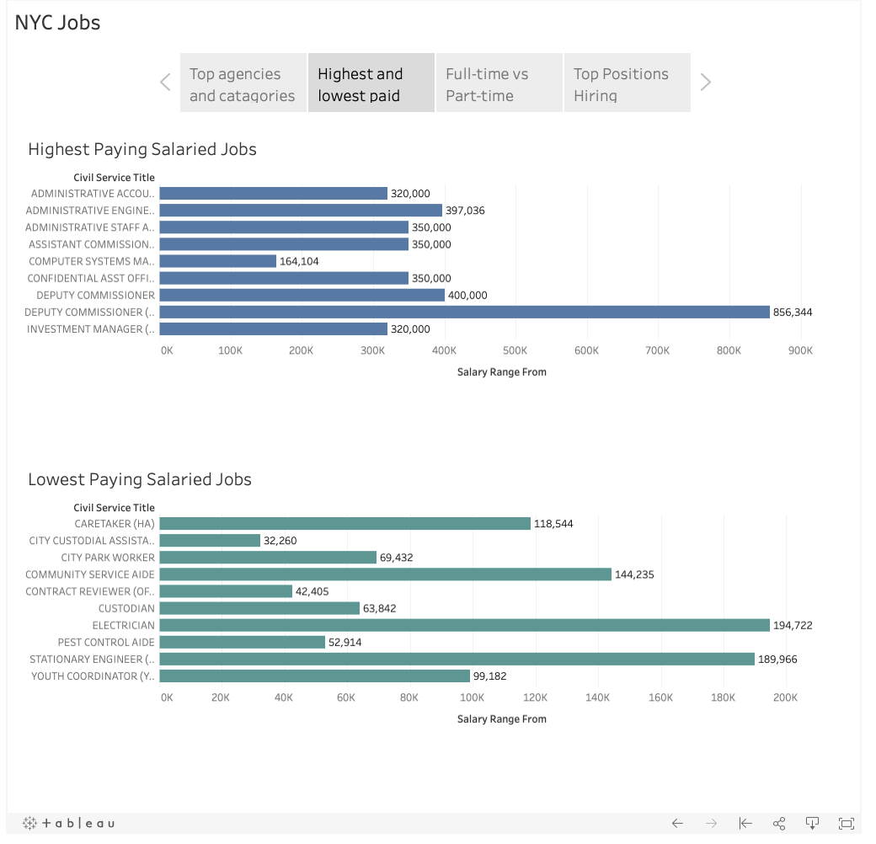
Highest lowest
Highest and Lowest paid positions by job title.
The Deputy Commissioner is the top paid.
The lowest paying job is the custodial assistant.

Slide 3
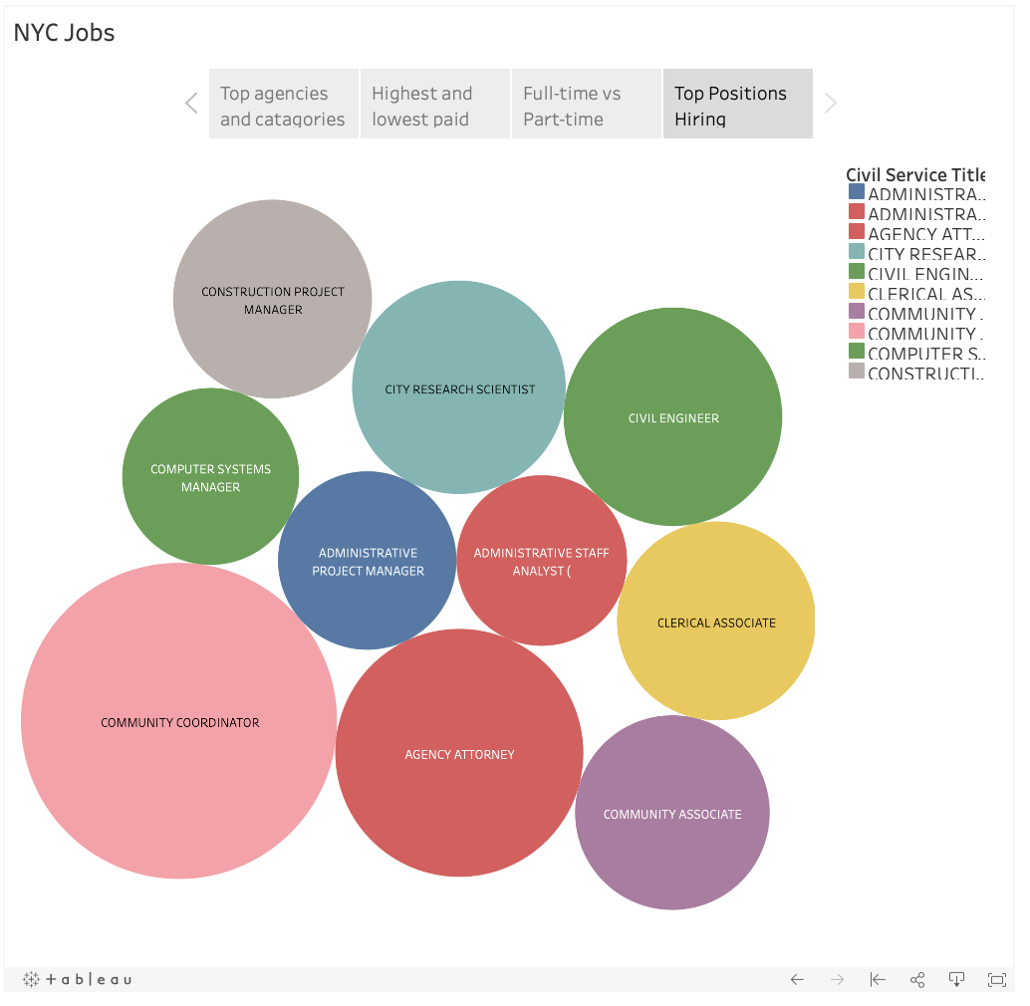
Top positions
Top 10 of positions offered the most often.
The job that is most often listed is community coordinator.

Slide 4
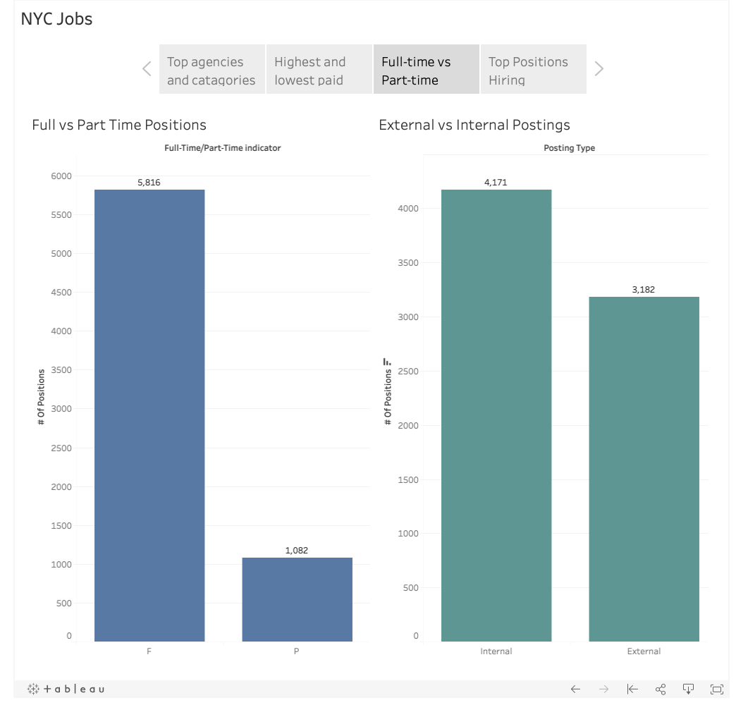
Comparisons
Full-time vs Part-time
More full-time positions are offered.
External vs Internal
More internal posts are made for hiring.

